Slide 1

Lecture #0
Artificial Intelligence
INT404

Slide 2
Course Overview
CSE510, Lovely Professional University, Phagwara
L T P :
Text Book:
“ARTIFICIAL INTELLIGENCE”, RICH, KNIGHT, Mc GRAW HILL , 3rd Edition (2009)
Reference books:
“ARTIFICIAL INTELLIGENCE: A MODERN APPROACH” by STUART RUSSEL, PETER NORVIG, PEARSON, 2nd Edition, (2012)
“Artificial Intelligence with Python “ by PRATEEK JOSHI, PACKT, 1st Edition,(2017)
3 | 1 | 0

Slide 3
CSE508, Lovely Professional University
Marks Breakup(Yet to be informed on UMS):
Activity | Marks
Attendance
Continuous Assessment (CA)*
Mid-Term Examination (MTE)
End-Term Examination (ETE)
Total | 100

Slide 4
12/12/14
CSE510, Lovely Professional University, Phagwara
Continuous Assignment( Best 2 out of 3)
ALLOCATION SUBMISSION
WEEK WEEK
CA1 4 5
CA2 8 9
CA3 10 11
* CA2 and CA3 dates can be changed in future

Slide 5
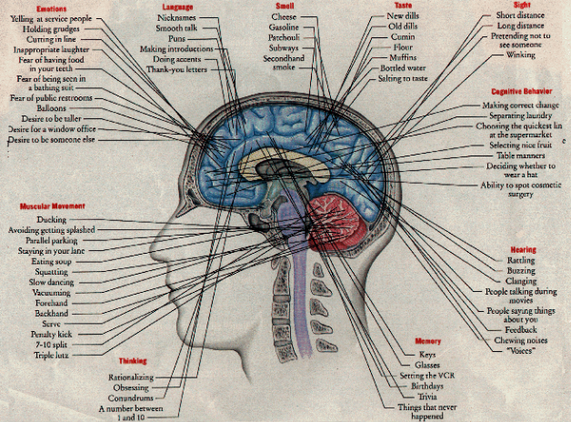

What is AI?
Mapping of Human brain
into machine
Human Brain

Slide 6
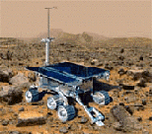

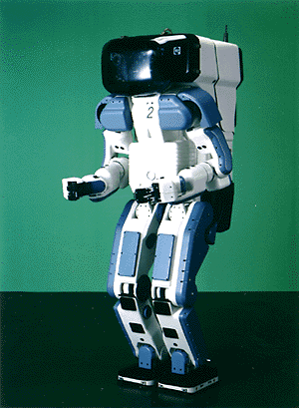

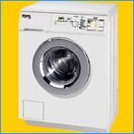
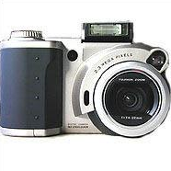
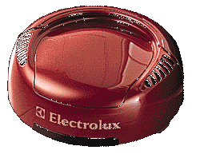
Why study AI?
Search engines
Science
Medicine/
Diagnosis
Labor
Appliances
What else?

Slide 7
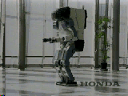
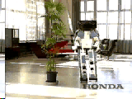
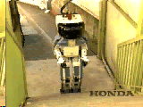
Honda Humanoid Robot
Walk
Turn
Stairs

Slide 8
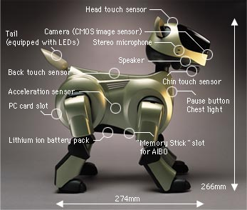
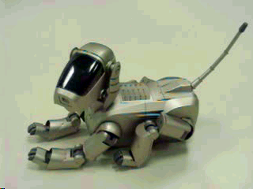
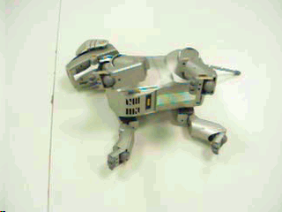
Sony AIBO

Slide 9
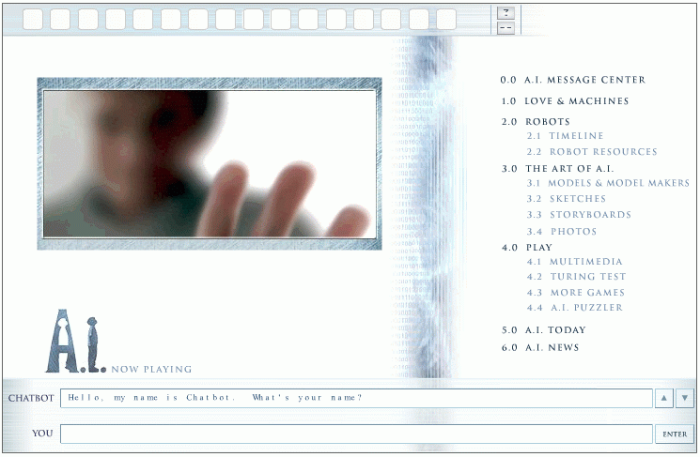
Natural Language Question Answering
http://aimovie.warnerbros.com
http://www.ai.mit.edu/projects/infolab/

Slide 10
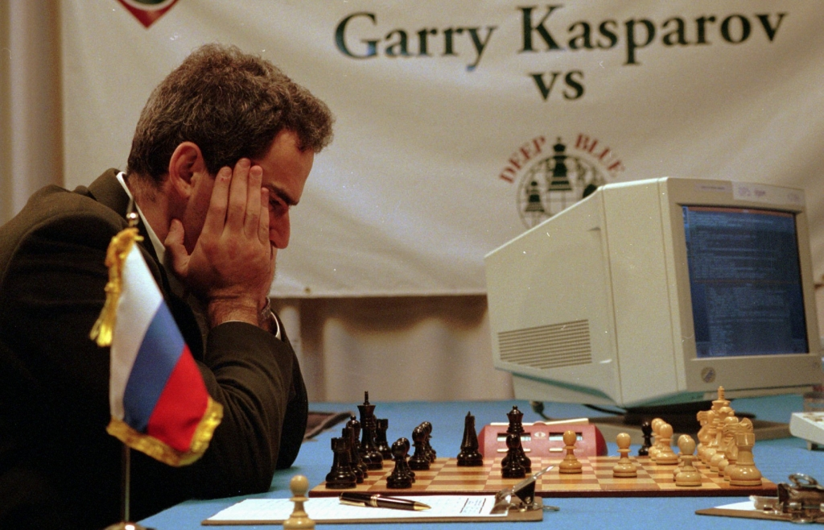
Milestone in the field of Artificial Intelligence

Slide 11
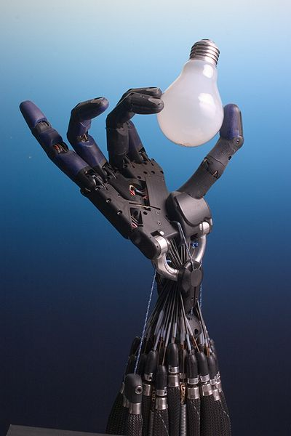
Robot holding electric bulb

Slide 12
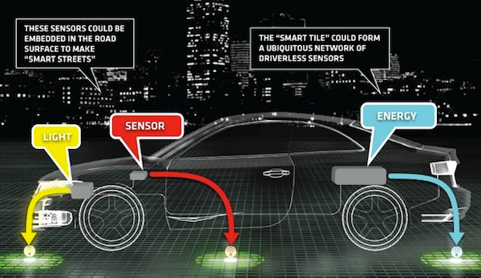
Driver-less Car

Slide 13
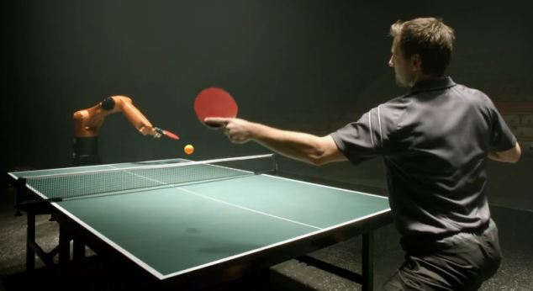
Human vs Robot Table Tennis game

Slide 14
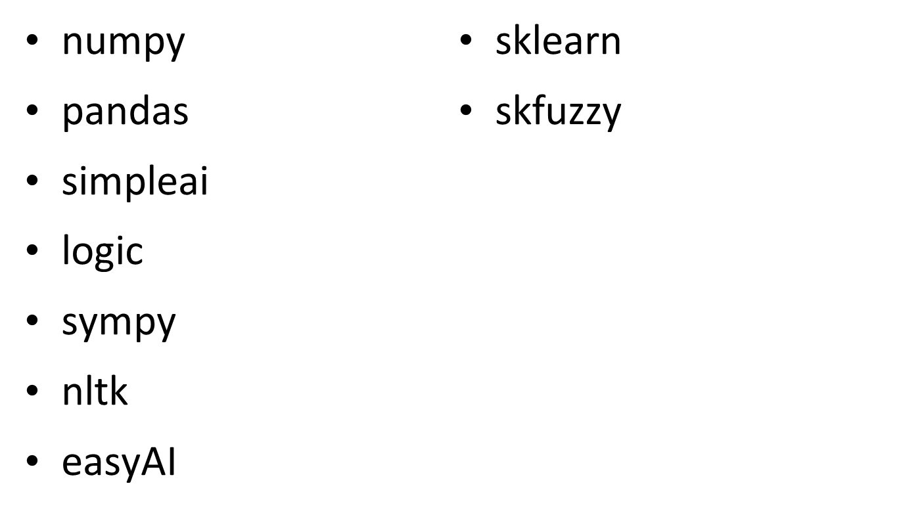
Python Packages Required for AI
12/12/14
CSE510, Lovely Professional University, Phagwara

Slide 15
CSE510, Lovely Professional University, Phagwara
Unit 1
- Introduction
What is Artificial Intelligence?
History of AI
Applications of AI
Branches of AI
defing intelligence using Turing Test
Making Machine think like human
Building rational agent
general Problem solver
Building an intelligent agent
Problem Spaces and Search
Problem characteristics
Production system and its characteristics

Slide 16
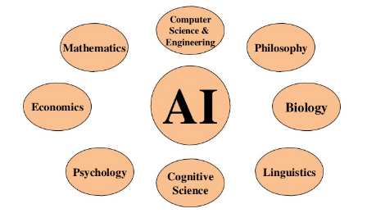
Foundations of AI
Unit 1

Slide 17
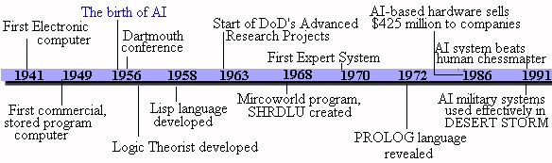
Time-line of AI
Unit 1

Slide 18
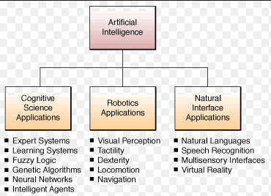
Application areas of AI
Unit 1

Slide 19
CSE510, Lovely Professional University, Phagwara
Unit 2
-Search Strategies
Uninformed Search strategies: Breadth first search (BFS), Depth first search(DFS)
Informed Search Strategies : Generate and Test, Hill Climbing, Best first search, A* algorithm, Constraint satisfaction Problem
Package Required : simpleai

Slide 20
CSE510, Lovely Professional University, Phagwara
Unit 3
Knowledge Representation & Knowledge Reasoning
Propositional logic
Predicate logic
CNF
Forward versus backward reasoning
solving problem using logic programming
Introduction to logic programming
understanding the building blocks of logic
Package required: logic, sympy

Slide 21
CSE510, Lovely Professional University, Phagwara
Unit 4
-Natural Language Processing
Introduction to Natural Language Processing,
phases of NLP
construction of parse tree
Tokenizing text data
word stemming
word lemmatizatio
Dividing text data into chunks
Bag of Words model
Applications of NLP,
Spell checking
Soundex algorithm
Package required: nltk
-

Slide 22
CSE510, Lovely Professional University, Phagwara
Unit 5
Building games using AI
Using search algorithms in games
Combinatorial search
Minmax Problem
Alpha-beta pruning
Negamax algorithm
Last Coin standing game
Tic-Tac-Toe game ,
Hexapawn game.
Package required: easyAI

Slide 23
CSE510, Lovely Professional University, Phagwara
Unit 6
- Advance topics in Artificial Intelligence
Definition of Machine Learning
Types of Machine Learning
Activation functions,
Single neuron model
neural network architectures
Genetic Operators
genetic algorithm and its application
Fuzzy logic
fuzzification and defuzzification
Mamdani fuzzy inference system
Package Required: sklearn, skfuzzy

Slide 24

CSE510, Lovely Professional University, Phagwara
Thank You !!!

